Slide 1
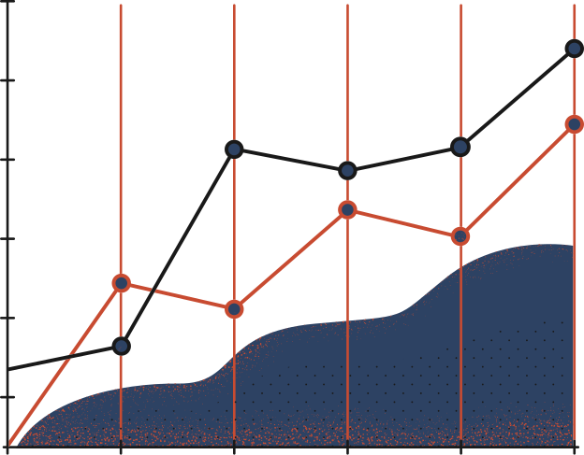

Wednesday, May 4
ANFIS Model for Stock Price Prediction
DONE BY,
Shravan G
shravan.g.cd.civ19@iitbhu.ac.in
Aadil M Moopan
aadilm.moopan.cd.civ19@iitbhu.ac.in

Slide 2

I
Introduction
The prediction of stock prices has always been an attractive studying area that many people are interested in as it has the ability to directly increase the chance of profiting for the financial interpreters. In this study, we worked on the problem of predicting the next days’ closing price of S&P 500 index.
ANFIS, adaptive neuro-fuzzy inference system, uses the given inputs and outputs of a dataset to construct a fuzzy inference system. ANFIS is the combination of both artificial neural networks and fuzzy logic.
2

Slide 3

II
Motivation
The prediction of stock prices has always been an attractive studying area that many people are interested in as it has the ability to directly increase the chance of profiting for the financial interpreters. In this study, we worked on the problem of predicting the next days’ closing price of S&P 500 index.
Being finance enthusiasts, we wanted to explore how technology can help us predict future market prices, which can help us make the right trades.
Many traditional time series models have been proposed and applied to economic forecasting. Recent advances in soft computing techniques provide suitable tools to predict chaotic environments, like stock market closing prices.
3

Slide 4

III
Technology
Model
ANFIS, Adaptive neuro-fuzzy inference system is a combination of both fuzzy inference system (FIS) and Artificial Neural Network (ANN).
Language
MATLAB
Functions used
MATLAB functions of GENFIS, ANFIS, FIS, TUNEFIS, EVALFIS, etc. were used.
4

Slide 5

IV
Methodology
Data Preparation
Daily closing prices of assets are considered to predict the closing price of the next day.
2 different datasets are created using the historical closing prices. The first one consists of the daily closing prices for the last 5 days. The second dataset consists of the closing prices of t-5 (last week, same day), t-10, t-15, t-20 and t-25(5 weeks back, same day).
5

Slide 6
IV
Methodology
2. Creation of Train and Test Datasets.
As the dataset consists of time series data, the training and test sets are generated by splitting the data into two parts without shuffling, based on the occurrence of the observations. The dataset is not shuffled. No sampling method is used.
Training data consists of 1000 data points, and the test data point is the closing price of the next day. The dataset is looped for 42 days (approximately 2 months) to generate outputs. SNP500 index’s closing prices are used to generate the predictions.
6

Slide 7
IV
Methodology
3. Building the FIS Model
There are three types of FIS models namely, Grid Partitioning, Subtractive Clustering and FCM Clustering modes.
Subtractive Clustering is focused on the calculation of the probability that a data point can be a cluster centroid by examining the distance metrics of relative data points.
Grid partitioning divides the whole input space into several fuzzy subspaces and specifies each value represented by them via a corresponding membership function.
Fuzzy C-Means clustering method is quite similar to the k-means algorithm and the number of clusters is set in the beginning, then the weights are randomly assigned to each data point.
7

Slide 8

IV
Methodology
4.1 Generating the ANFIS Model
ANFIS, or adaptive neuro-fuzzy inference system, uses the given inputs and outputs of a dataset to construct a fuzzy inference system. Like a neural network, The membership functions’ parameters are adjusted by the backpropagation algorithm or least-squares algorithm. ANFIS is the combination of both artificial neural networks and fuzzy logic. The classical ANFIS model consists of five layers.
8

Slide 9
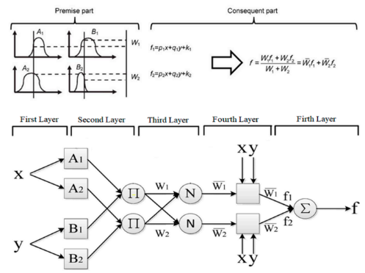
IV
Methodology
4.2 Generating the ANFIS Model
First layer is the input layer. There are square nodes in the mid-layers with different output rules. The single node in the fifth and last layer computes the output, by summing all the inputs coming from the prior layers.
Fig: ANFIS structure
9

Slide 10
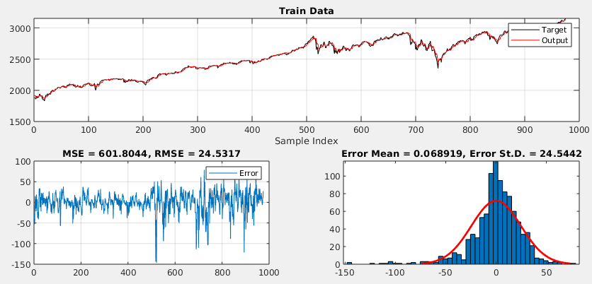
V
Results and Conclusion
S&P500 index’s closing prices are used to generate predictions of next days’ closing price. There are two sets of inputs: one consisting of daily closing price data and the other containing weekly closing prices. A total of 6 ANFIS models are generated on these two datasets using Grid Partitioning, Subtractive Clustering and FCM Clustering modes of ANFIS. After that, each model is tuned to find out the optimal hyperparameters. An ensemble model is built by taking the average of the tuned models.
10
Fig: Training dataset and associated errors

Slide 11
VI
Discussion
However, using parameter tuning significantly increases the prediction accuracy. Counterintuitively, use of parameter tuning does not decrease the prediction errors in the day-by-day prediction case.
This result might point that hyperparameter tuning is more important for long term results with higher uncertainty.
As a conclusion, ANFIS is a powerful tool for time series prediction. Even without using complex combinations or ensemble models, the model can produce R squared values higher than 90%. As a future work, the model can be run on different stocks or indices.
11

Slide 12



VII
References
Wikipedia
https://en.wikipedia.org/wiki/Adaptive_neuro_fuzzy_inference_system
MATLAB
https://in.mathworks.com/help/fuzzy/neuro-adaptive-learning-and-anfis.html
Research Papers
https://www.researchgate.net/publication/271337881_A_Predictive_Stock_Market_Technical_Analysis_Using_Fuzzy_Logic
https://www.researchgate.net/publication/284205028_Predicting_Closing_Stock_Price_using_Artificial_Neural_Network_and_Adaptive_Neuro_Fuzzy_Inference_System_ANFIS_The_Case_of_the_Dhaka_Stock_Exchange
12

Slide 13

The End
Thank you
for listening

